Slide 1
Regulations on Agriculture
Patrick McCarthy- Columbia County Conservation District

Slide 2
Terms
Clean Streams Law of 1937: regulates discharges which cause or contribute to water pollution
Chapter 91: guidance on manure management and waste storage
Chapter 102: Erosion & Sediment Pollution Control Program
Nutrient & Odor Management Act of 2005 (Act 38)
Concentrated Animal Feeding Operation (CAFO)
Based on animal numbers and/or animal density
Concentrated Animal Operation (CAO)
Operation with more than 2,000lb/acre density

Slide 3
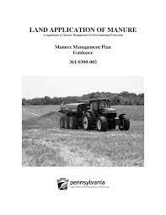
Manure Management Plans
Needed for any operation that is not a CAO or CAFO
Documents animal housing and waste storage facilities
Plan can be self-developed or with public/ private assistance
Valid for as long as they accurately reflect the operation
Requires maps of all cropland with setbacks on wells and waterways
100 ft. from all wells
100 ft. from water bodies or 35 ft. if permanent vegetative buffer is in place

Slide 4
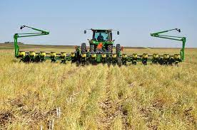
Ag Erosion & Sedimentation Plans
Aim to prevent accelerated erosion on earth moving activities over 5,000 sq. ft.
Factors in operator’s tillage, crop rotation, field slope, and conservation practices ( filter strips, cover crops, etc.)
Each field has maximum allowable soil loss
Additional conservation practices are required if a field’s soil loss exceeds allowable level

Slide 5
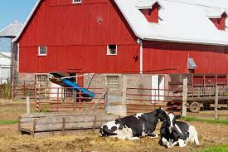
Concentrated Animal Operation
Any operation with more than 2,000 lbs. of animals per acre of cropland on an annual basis
Based on standard animal weights table developed by PSU
Examples
150 cows per 100 acres of cropland
1500 hogs per 100 acres of cropland
25 horses per 10 acres of cropland
Must be at least 8 total animal units
Regulated by Act 38

Slide 6
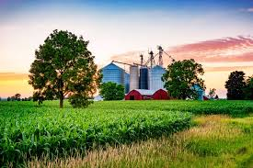
Concentrated Animal Feeding Operation
Operations with over 1,000 animal equivalent units under one entity's control
Required to develop an Act 38 Nutrient Management Plan and a DEP NPDES permit

Slide 7
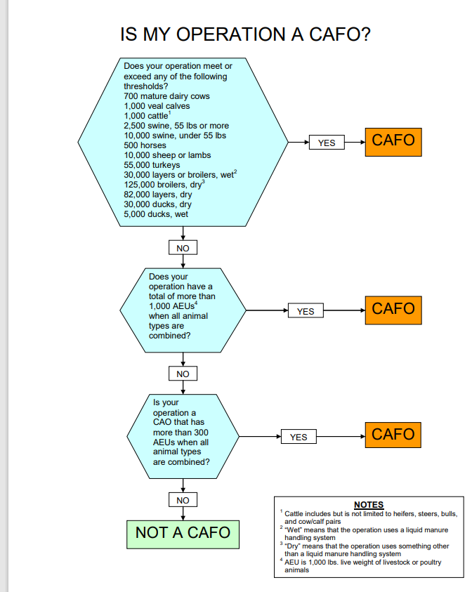

Slide 8
Nutrient Management Plans
Identify nutrient sources on farms
Describes the number of animals on the operation and the farmer’s management strategy
Determines application rates and restrictions
Determines how excess manure will be stored and handled
Describes conservation practices that need to be implemented
Program is overseen by the State Conservation Commission
Administered by the local conservation district

Slide 9
Nutrient Management Plans
Must be developed by a certified private consultant
Must be updated every three years
District staff review plans and work with planner to correct issues and ensure plan follows state guidelines
Act 38 operations are subject to a yearly status review
Review records
Ensure waste storages are functioning properly
DEP staff also review CAFO NMP’s and do regular site visits to ensure compliance

